Slide 1
Risk based sampling for Phytophthora in nurseries
Dr. Johanna Del Castillo Múnera
Department of Plant Pathology, UC Davis
CALPHYTOS meeting
November 8, 2023

Slide 2
Selecting nursery stock for Phytophthora testing
Which plants should I test?
How many plants to test ?

Slide 3
Which plants should I test?
Symptomatic plants

Slide 4
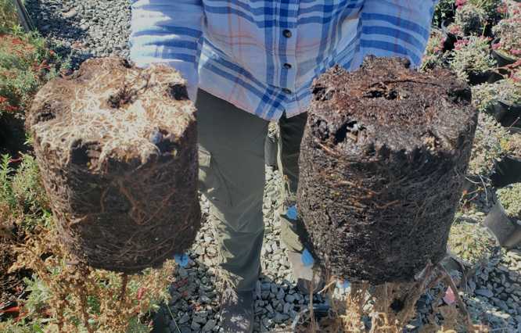
Which plants should I test?
Symptomatic plants

Slide 5
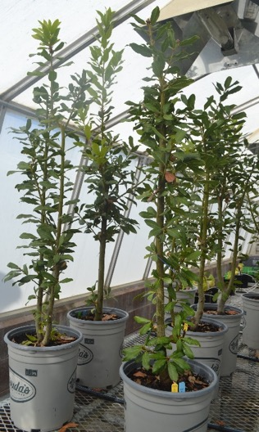
What if there are few or no symptomatic plants?
Phytophthora infected plants can remain asymptomatic for long periods of time.

Slide 6
What if there are few or no symptomatic plants?
Select plants based on risk of contamination
Plant propagule source
High risk: Nurseries not following Nursery Phytophthora BMPs, cultivated landscapes, gardens
Low risk: Nurseries following NPBMPs, propagules from healthy native plants in remote areas

Slide 7
What if there are few or no symptomatic plants?
Select plants based on risk of contamination
Plant propagule type
High risk: Propagules in contact with the soil
Low risk: Clean seeds, tip cuttings

Slide 8
What if there are few or no symptomatic plants?
Select plants based on risk of contamination
Plants in the nursery
Plant age
High risk: Older plants (more than one growing season)
Lower risk: Young plants

Slide 9
What if there are few or no symptomatic plants?
Select plants based on risk of contamination
Plants in the nursery
Plant location
High risk: Close to sources of contamination
Known infected plants
Plant material not grown in the nursery
Watercourses, exterior fences, entrances
Lower risk: Plants well separated from sources of contamination

Slide 10
What if there are few or no symptomatic plants?
Select plants based on risk of contamination
Plant species
High risk:
Flowering plants (dicots)→ shrubs, trees, bedding plants
Known susceptible hosts: Arbutus, Arctostaphylos, Ceanothus, Cistus, Diplacus, Heteromeles, Rhamnus
Conifers, non-grass monocots
Low risk: Grasses, ferns

Slide 11
What if there are few or no symptomatic plants?
Select plants based on risk of contamination
Planting sites
High risk:
Very rare habitats
Close to sensitive species at planting sites
Pristine locations
Test at highest rate as possible
https://ca.audubon.org/news/rare-coastal-sage-scrub-habitat-provides-home-threatened-gnatcatcher-and-many-other-species

Slide 12
What to prioritize when testing ?
Prioritize testing any of the high-risk scenarios :
Symptomatic plants, older plants known to be Phytophthora hosts, plants close to sources of contamination, propagation material collected from the soil, plants coming for other nurseries.
If you have to choose what not to test, select low risk scenarios:
Grasses, young plants grown under NPBMP, clean seeds, tip cuttings, plants separated from contamination sources

Slide 13
How many plants should I test?
There is a no set number of plants to test. Phytophthora detection is affected by:
Sampling method used
Infection rate → The lower the infection level, the more plants that need to be tested to get a positive result
Depending on the plant batch size, test as many plants as feasible
Smaller batches: Ideally, test 100% of the plants
Larger batches: Select plants to test based on risk of contamination

Slide 14
Summary
Select plants to test based on symptoms and risk of contamination
Use a detection method that has higher likelihood of Phytophthora detection: Leachate baiting test.
If testing individual plants: bait from the root ball

Slide 15
Resources
http://phytosphere.com/BMPsnursery/test2numsamp.htm
http://phytosphere.com/BMPsnursery/test2_2whattotest.htm
http://phytosphere.com/BMPsnursery/test2_3teststrat.htm

Slide 16
Thank you!
Questions ?
https://greenhousepathology.faculty.ucdavis.edu/
jdelcastillo@ucdavis.edu

Slide 17
Acknowledgement
Susan Frankel
Ted Swiecki
Diana Benner

